Slide 1
Formation of Chinese dialects
Migration of Chinese people from 221 B.C. onwards

Slide 2
Qin territory (221 B.C.)

Slide 3

History of China in 8 Minutes: Territorial Changes of Every Dynasty

Slide 4
Chinese dialects emerged due to successive migration from Northern China to Southern China

Slide 5
221 B.C.
601 A.D.
1324 A.D.
2021 A.D.
Mandarin

Slide 6
221 B.C.
601 A.D.
1324 A.D.
2021 A.D.
Cantonese
Hakka
Mandarin
Min

Slide 7
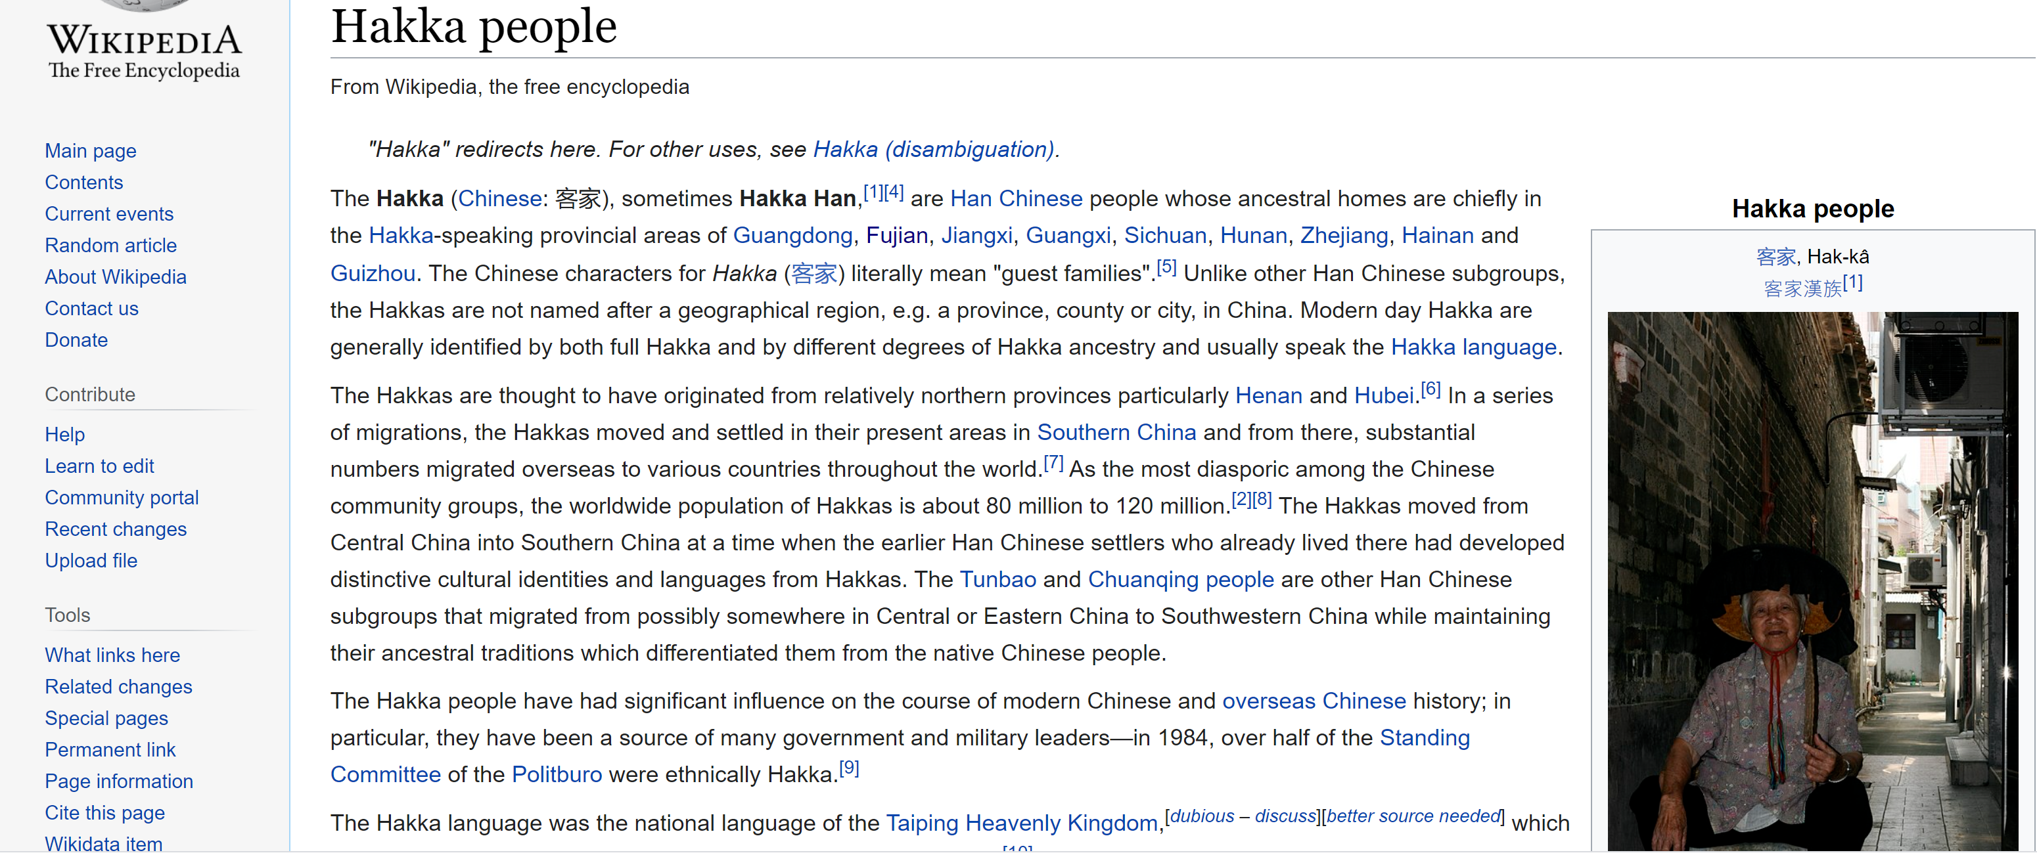

Slide 8
Language contact in ancient China
New lexical item being introduced into Chinese
Basic vocabulary
An example
‘elder brother’
兄 xiong
哥 ge

Slide 9
A final question for you
Can Chinese dialects be called Chinese languages?

Slide 10
Various Chinese dialects = Various Chinese languages?

Slide 11


Slide 12
What is a dialect in linguistics textbook？
Dialect refers to a regional variety of a language spoken in a particular area
Size of the area does not matter; distinguished by differences in pronunciation, vocabulary, and grammar
The dialects or varieties of a particular language are closely related and, despite their differences, are most often largely mutually intelligible,

Slide 13




Are English, German, Dutch and Danish different languages or different dialects of the same language?

Slide 14
Indo-European languages

Slide 15
What is Chinese dialect？
Chinese dialect refers to a regional variety of the Chinese language spoken in a particular area
Size of the area does not matter; distinguished by differences in pronunciation, vocabulary, and grammar
The dialects or varieties of a particular language are closely related and, despite their differences, are most often largely mutually unintelligible,

Slide 16
Various Chinese dialects = Various Chinese languages!

Slide 17
Sinitic languages
link

Slide 18
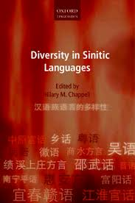
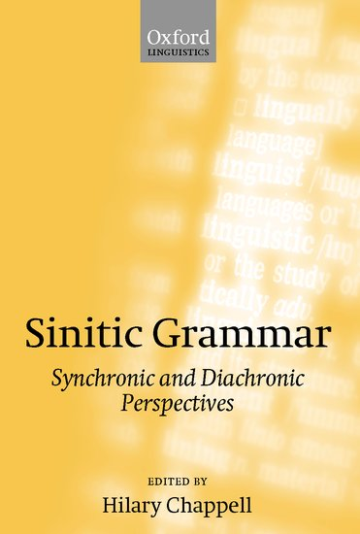

Slide 19
Sinitic languages
Cantonese language
Mandarin language
Min language
Hakka language
Various Chinese languages
Hokkien dialect
Teochew dialect

